Slide 1


SECTION 4 -
FLOOR FRAMING

Slide 2
4.1.1 Scope
4.1 GENERAL
This Section sets out the requirements for the construction of timber-framed floors and, where applicable, decks, verandahs, and the like, and shall be used in conjunction with Span Tables 1 to 6, 33 to 35 and 49 and 50 given in the Supplements.

Slide 3
4.1.2 Materials
Any timber species may be used for floor framing, provided it is kept dry; that is, not exposed to weather, well ventilated, not in contact with or close to the ground (see Clause 1.10 and Clause 3.3).
When constructing floors that are exposed to the weather (decks, verandahs), attention shall be given to the durability of materials and detailing required to ensure an adequate service life (see Clause 1.10).

Slide 4
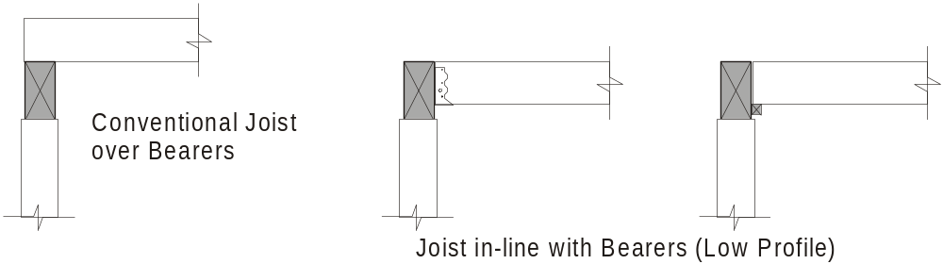
4.1.3 Framing configurations
Various configurations of bearers and joists may be used to support flooring at either the ground level, or at the first floor level including conventional joists over bearers and joists in line with bearers (low profile floor framing).

Slide 5
4.1.4 Weatherproofing
The detailing of wall cladding, flashings and damp-proof course in any construction except for decks shall be such that timber floor frame members will be protected from the weather or ground moisture rising through the substructure.

Slide 6
4.1.5 Shrinkage
Where large unseasoned timber members or members with different shrinkage characteristics are used, allowance shall be made for shrinkage.
NOTE: Shrinkage associated with the use of seasoned or small section unseasoned bearers and joists (overall depth of floor frame less than 200 mm) is usually of minimal significance to the overall performance of the structure (see Figure F1 in Appendix F).

Slide 7
F3 ALLOWANCE FOR SHRINKAGE
Appendix F
Allowance should be made for the effects of shrinkage where any one of the following conditions applies:
  (a) Unseasoned members are used.
  (b) Materials with different shrinkage characteristics are combined.
  (c) Unseasoned timber is used in conjunction with seasoned timber or other non-timber products.
  (d) Openings occur in external brick veneer.
  (e) In multistorey construction.
  (f) In multi-residential timber-framed fire-rated construction.

Slide 8
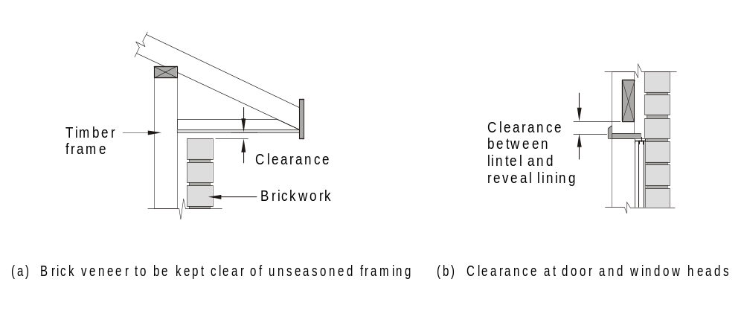
F3 ALLOWANCE FOR SHRINKAGE
Appendix F
FIGURE F1 ALLOWANCE FOR SHRINKAGE

Slide 9
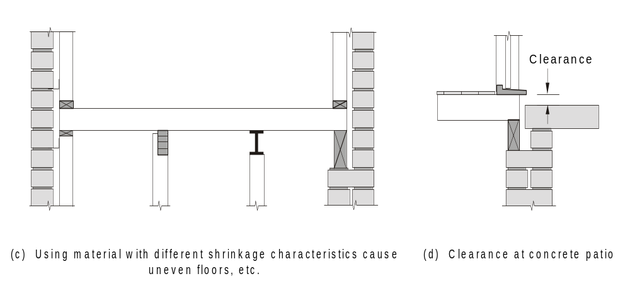
Appendix F
F3 ALLOWANCE FOR SHRINKAGE
FIGURE F1 ALLOWANCE FOR SHRINKAGE

Slide 10
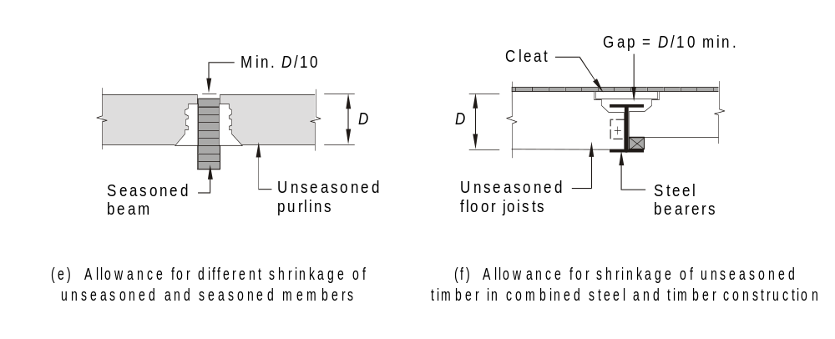
F3 ALLOWANCE FOR SHRINKAGE
Appendix F
FIGURE F1 ALLOWANCE FOR SHRINKAGE

Slide 11
4.1.5 Cuts, holes and notches in bearers and joists beams and rafters
Cuts, holes and notches shall not exceed the sizes, nor be at closer spacing than, given in Figure 4.1.
These are also applicable to some Roof Framing Members - See Section 7.
Unless otherwise specified, the member size shall not be reduced by any other method to a net section size less than that required to achieve the span requirements.

Slide 12
4.1.5 Cuts, holes and notches in bearers and joists beams and rafters
Only one surface at the end of any member shall be notched.
NOTES:
1 Significant imperfections, such as knots, should be regarded as holes with respect to the hole spacing limitations given in Figure 4.1.
2 Engineered timber products may have their own specific limitations (see Clause 1.14).

Slide 13
These allowances for cuts, holes and notches are given to allow for installation of plumbing and electrical services and also tie-down.
The notching can also be utilised to decrease the overall depth of floor framing.
This reduction in floor framing depth may also lead to savings in other materials by reducing the ground to top of floor height and/or reduce the total shrinkage when using unseasoned floor framing .... for example......

Slide 14
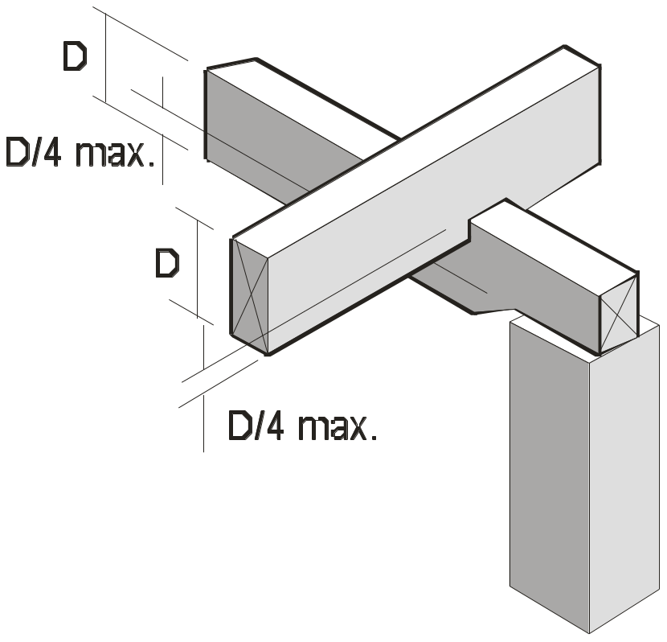
If the depth of the bearer is 200mm and the joist 175mm, each of these members can be reduced by ¼ (25%).
The overall depth of this bearer/joist system is reduced by approx. 90mm which could reduce the possible shrinkage by 6 to 8 mm.

Slide 15
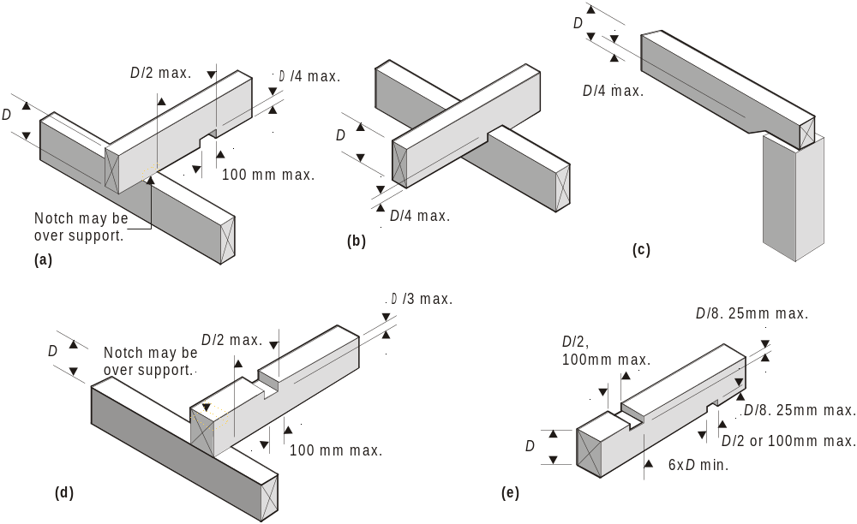
FIGURE 4.1 NOTCHES, CUTS AND HOLES IN BEAMS, BEARERS, JOISTS, RAFTERS
A4

Slide 16
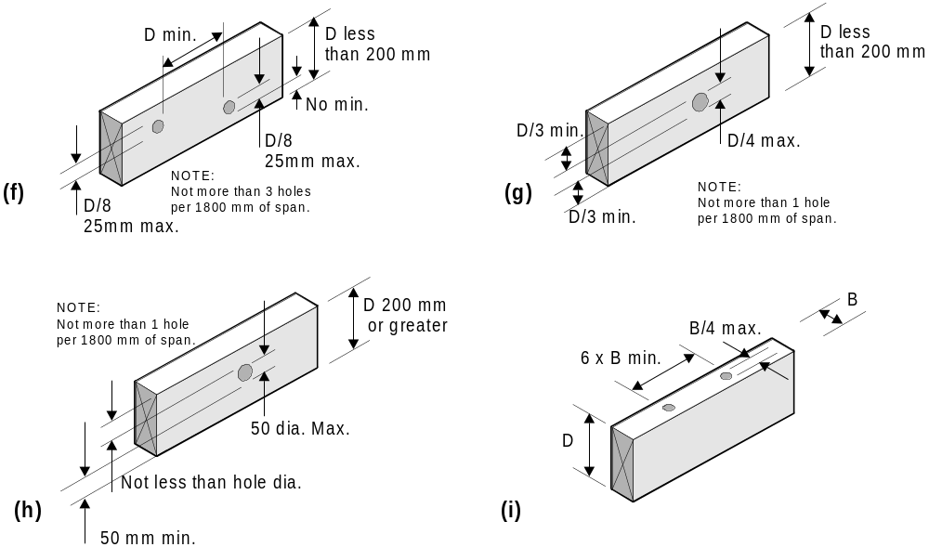
FIGURE 4.1 NOTCHES, CUTS AND HOLES IN BEAMS, BEARERS, JOISTS, RAFTERS

Slide 17
NOTE: The details given in Figure 4.1 do not apply to holes required for the provision of tie down bolts at member support positions.
These holes may be inserted in addition to the notching limitations at supports. Holes for tie-down bolts away from supports shall be spaced in accordance with Figure 4.1 (e).

Slide 18
4.2 BUILDING PRACTICE
4.2.1 Bearers
4.2.1.1 General
Where required, bearers shall be levelled, preferably by checking (notching) out the underside over supports.
this refers to unseasoned timber where the allowable tolerances of the timber size is + or – 3mm.

Slide 19
4.2.1.1 Bearers General
Packing of minor deficiencies in depth is permitted, provided the packing is a corrosion-resistant, incompressible material over the full area of support.
Bearers with minor spring, within the allowable limits, shall have the spring placed upwards to allow for straightening under loading.
allowable limits for spring are those given in the stress grading standards such as – AS2082 (hardwood) AS2858 (softwood).

Slide 20
4.2.1.1 Bearers General
Joints in bearers shall occur only over supports, with adequate bearing for both members.
Figure 4.2 shows various connection methods that can be used over supports.
All cuts shall be located over a support.
The minimum bearing each side of a join shall be 50 mm. …. by the full width of the bearer or equivalent area.

Slide 21
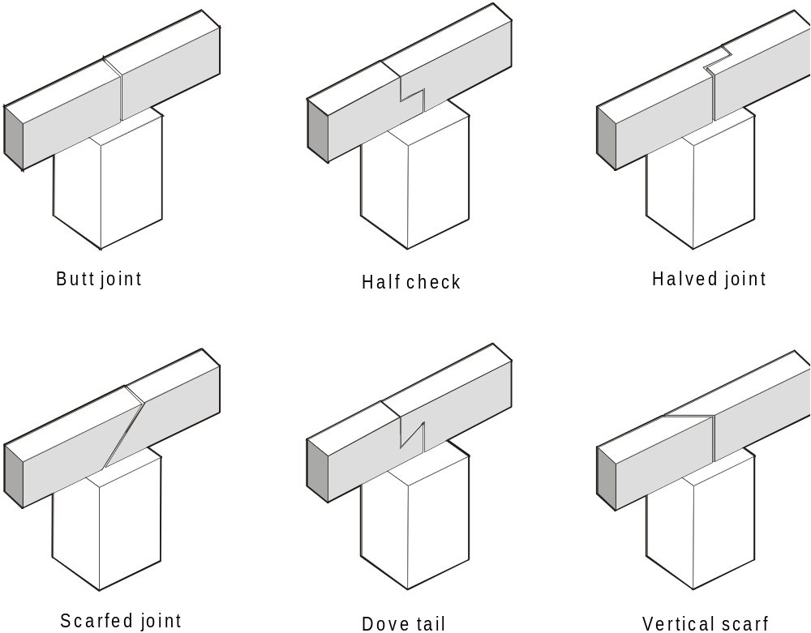
FIGURE 4.2 BEARER SUPPORTS (ALTERNATIVES)

Slide 22
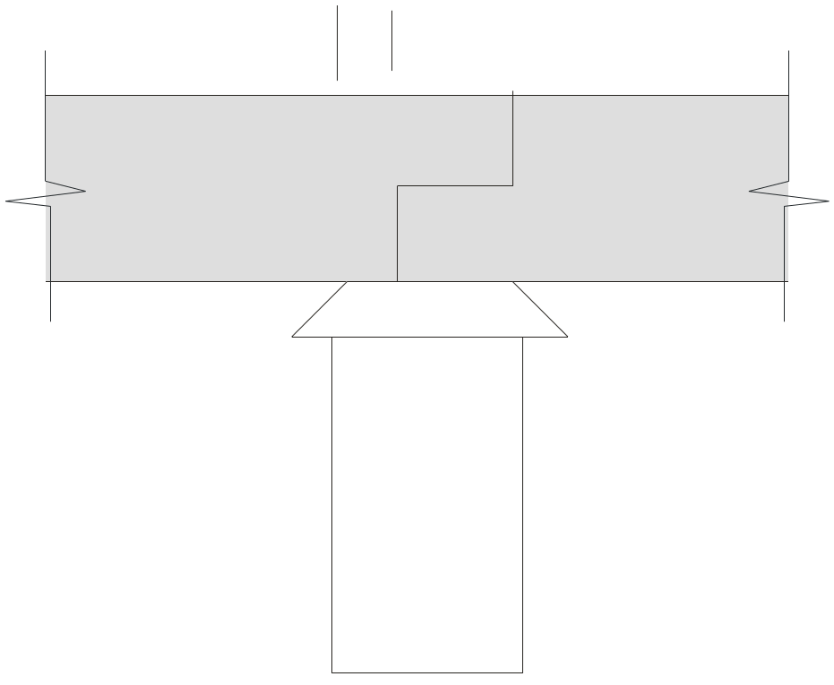
The minimum bearing
each side of a join
shall be 50 mm.
All cuts shall be located over a support.
This cut must be over the supporting stump, pier, post etc.
50 mm min.
50 mm min.

Slide 23
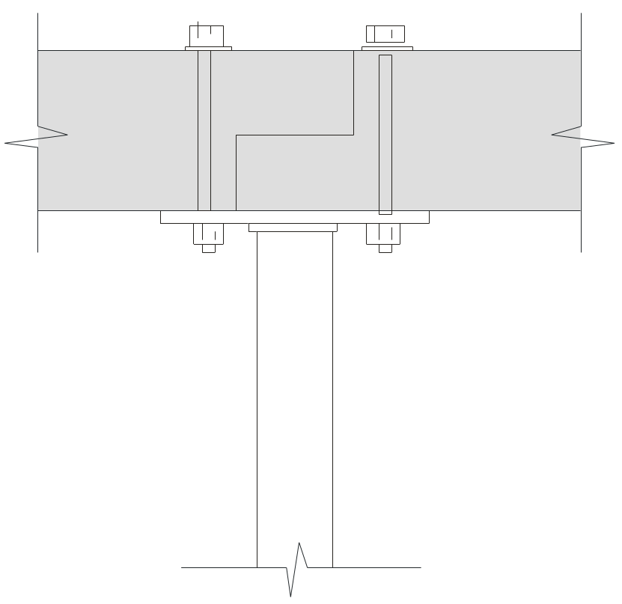
The minimum bearing
each side of a join
shall be 50 mm.
All cuts shall be located over a support.
This cut must be over the supporting stump, pier, post etc.
50 mm min.
Full width of flange may be used for bearing.

Slide 24
4.2.1.1 Bearers General
NOTES:
Bearers may be planed to within the allowable tolerances of the member specified.
Some engineered nailplated products may permit joins to occur other than over supports (see Clause 1.14).

Slide 25
4.2.1.2 Fixing of bearers to supports
Bearers shall be fixed to their supporting stumps, posts or columns in such a manner as will give adequate bearing and provide restraint against lateral movement (see Clause 9.7). (Shear Forces)
Clause 9.7 states …. “Shear forces (lateral wind forces) are required to be resisted by connections at the bearer and joist level of the house to prevent ‘sliding’.”

Slide 26
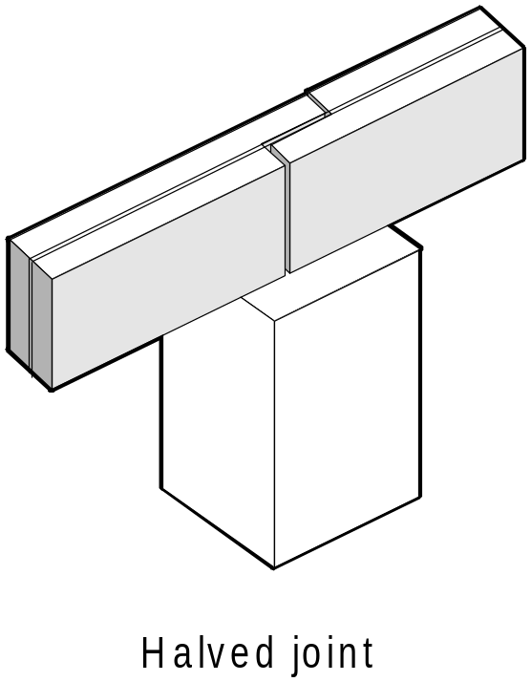
4.2.1.3 Built-up bearers
The required breadth of larger section bearers may be obtained by vertically nail-laminating thinner sections together (see Clause 2.3).
Any of the joining methods shown in AS1684 Figure 4.2 are also suitable for vertically nail laminated bearers.
A typical modification of these joining methods for vertical nail laminated bearers is shown at left.

Slide 27
4.2.1.4 Double bearers (spaced bearers)
The required breadth of larger bearers can be obtained by using spaced double bearers. Spacer blocks shall be placed between the bearers and, where relevant, at supports, at the intervals specified in Table 4.1.
Spaced bearers are typically used in pole frame construction.

Slide 28
4.2.1.4 Double bearers (spaced bearers)
This method is applicable to seasoned and unseasoned timber, however there are no 38 mm or 50 mm bearer sizes given for unseasoned timber in the span tables.
Where appropriate, this method can be used for in stead of vertical nail lamination.

Slide 29
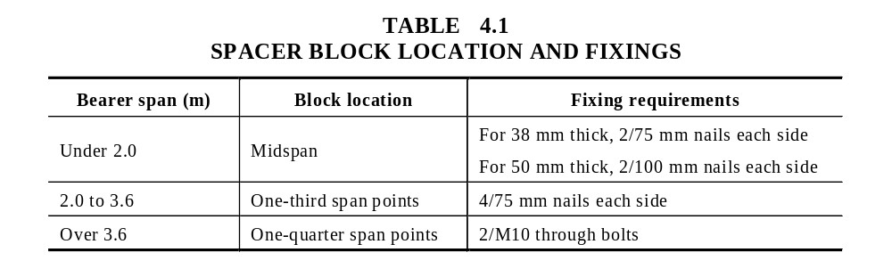
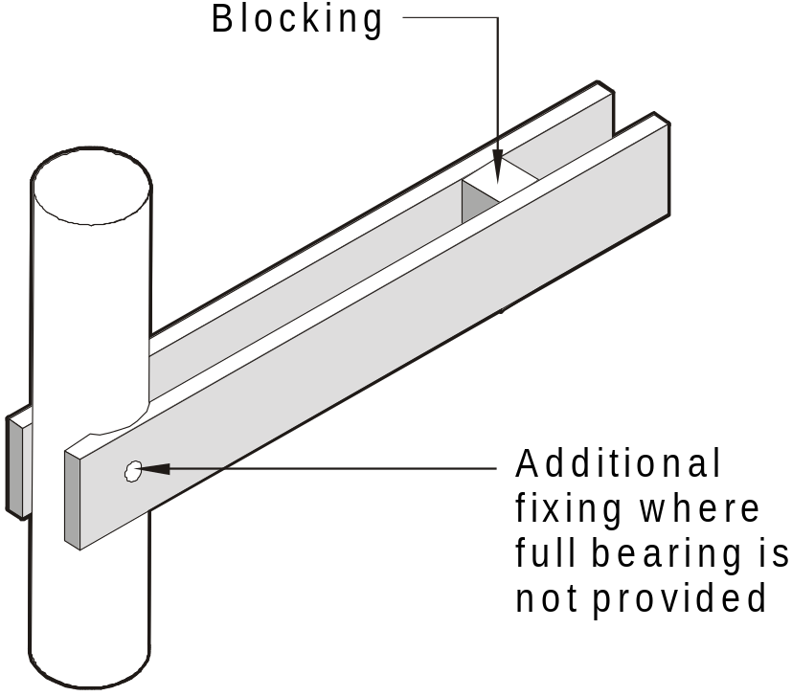
FIGURE 4.3 DOUBLE BEARER

Slide 30
4.2.2 Joists
4.2.2.1 General
Joists shall be laid with their top surfaces level to receive flooring. The undersides of joists having minor excesses shall be notched over bearers in order to bring them to the required level.
Packing of joists having minor deficiencies in depth may be utilized, provided the packing is fixed and is of corrosion resistant and incompressible material over the full area of contact.

Slide 31
4.2.2.1 General
Spacing of joists shall be determined by the span capacity of the flooring (see Section 5).
This is a very important point to note, as the span capacity of the strongest 19mm thick hardwood flooring is 520mm and some pine flooring can be only 390mm. 19mm thick hardwood decking is 500mm and 22mm pine decking is 450mm.

Slide 32
4.2.2.1 General
Joists having minor spring (within allowable limits) shall be laid such as to allow for straightening under loading.
i.e. spring up
allowable limits for spring are those given in the stress grading standards such as – AS2082 (hardwood) AS2858 (softwood).

Slide 33
4.2.2.1 General
Regardless of their length, if joists are partially cut over supports to correct bow or spring they shall be deemed to be supported at two points only (single span).
Where cuts are used to correct bow or spring, they shall be located centrally over the support, so that each side of the cut section is adequately supported.

Slide 34
4.2.2.1 General
Joints in joists shall be as shown in Figure 4.4 and shall be made only over bearers or supports.
Joists joined over bearers or supports shall have minimum 30 mm bearing for each joist.
Joints in joists that are required to be in line (for example, supporting wall plates or fitted flooring) shall be butted or scarfed, but shall not be lapped.

Slide 35
4.2.2.1 General
Note: Lapping joists, irrespective of how much they are lapped or fixed, does not allow the continuous span tables to be used unless specifically engineer designed.

Slide 36
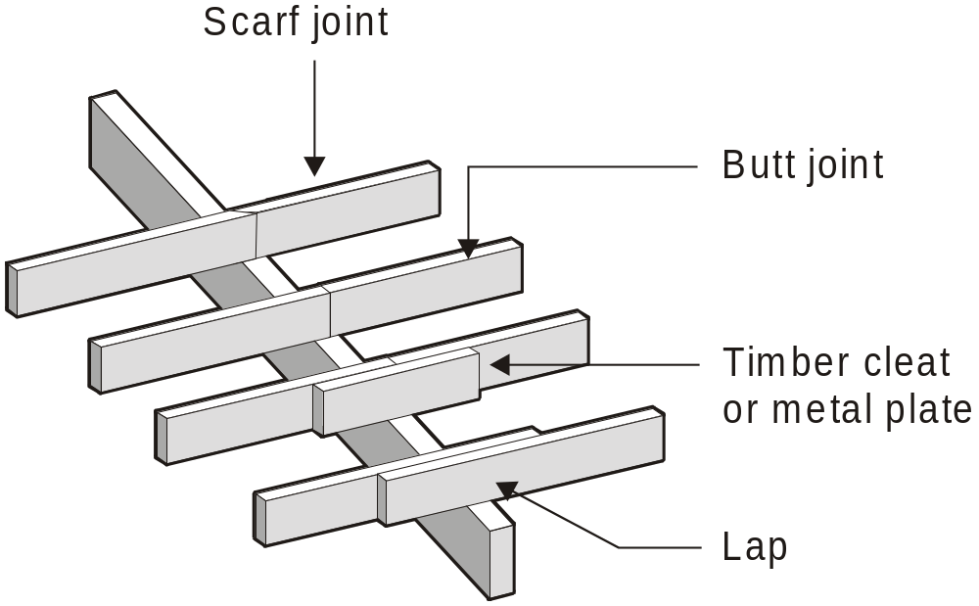
A3
FIGURE 4.4 METHODS OF JOINING JOISTS

Slide 37
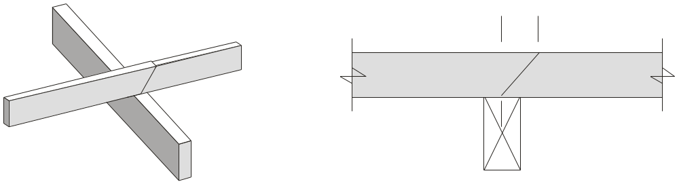
The length of the scarf 'S'
to be no greater than twice
the bearing length
Scarf joint.
S
30mm min.
bearing each
side of joint.
ALTERNATE SCARF JOINT

Slide 38
4.2.2.2 Location of joists
The following apply:
(a) Fitted flooring
For flooring that abuts wall plates, a pair of joists shall be provided under each wall that is parallel to the direction of the joists. These joists shall be spaced to provide solid bearing and fixing for the bottom wall plate and to project not less than 12 mm to give support for fixing of the flooring (see Figure 5.1).

Slide 39
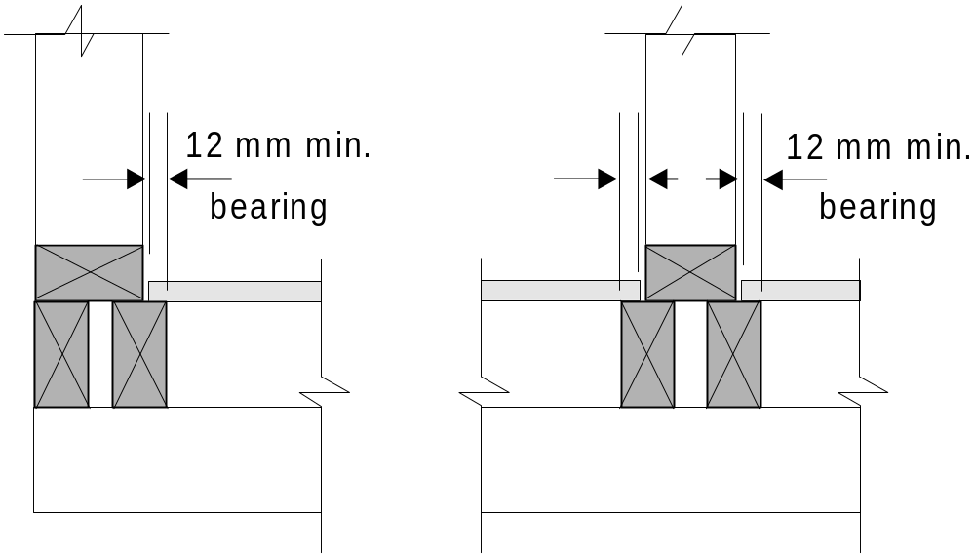
4.2.2.2 (a) Fitted flooring
Joists suitably spaced to provide bearing for bottom plate and flooring.

Slide 40
4.2.2.2 Location of joists
(b) Platform flooring
Where flooring is continuous under wall plates, joists shall be provided directly under all loadbearing walls parallel to the joists.
A single joist only is required under external non-loadbearing walls.
Joists are not required under internal non-loadbearing walls except as required to support flooring.

Slide 41
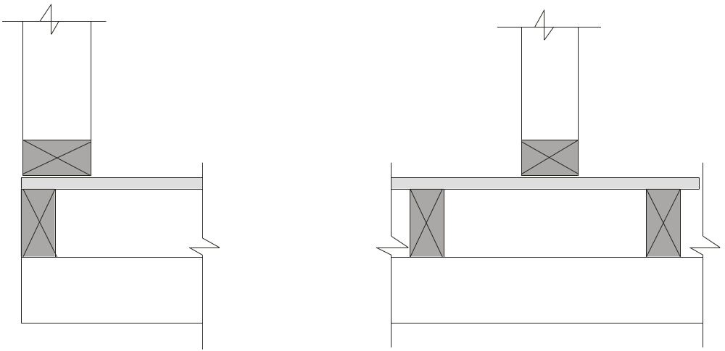
4.2.2.2 (b) Platform flooring
Non-loadbearing walls.
Single joist only under external non-loadbearing walls.
Joists are not required under internal non-loadbearing walls.

Slide 42
4.2.2.3 Deep joists
Where the depth of floor joists is equal to or exceeds four times the breadth (deep joists), the joists shall be restrained at their supports with either—
(a) a continuous trimming joist provided to the ends of joists above external bearers or wall plates; or
(b) solid blocking or herringbone strutting between the outer pairs of joists and between intermediate pairs at not more than 1.8 m centres.

Slide 43
4.2.2.3 Deep joists
Trimmers or solid blocking may be 25 mm less in depth than the joists (see Figure 4.5) or other equivalent method for the purpose of ventilation. Trimmers or solid blocking shall be a minimum thickness of 25 mm.
A4

Slide 44
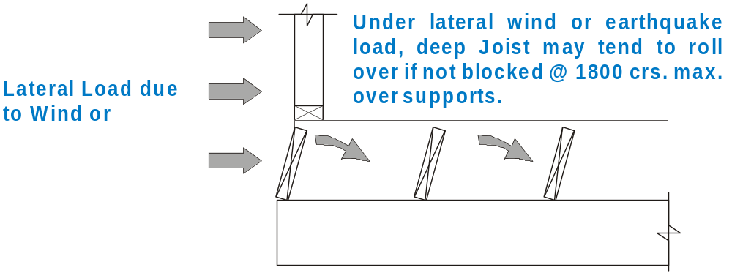
4.2.2.3 Deep joists
This restraint is required to stop the floor joist ‘rolling over’ due to lateral loads on the building such as from wind or earthquake.

Slide 45
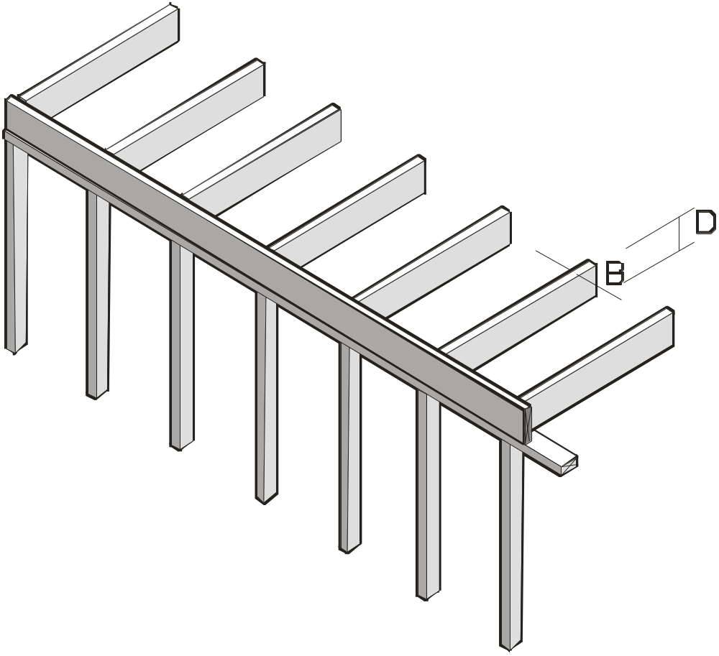
4.2.2.3 (a) continuous trimming joist provided to the ends of joists
Trimming joist
Deep floor joist.
Depth (D) equal to or
greater than 4 x breadth (B)
Lower storey
top plate or bearer

Slide 46
NOTE: Where a continuous trimming joist is provided to the ends of joists above external bearers or wall plates, solid blocking or herringbone strutting, at not more than 1.8 m centres, shall also be provided to internal bearers or wall plates.

Slide 47
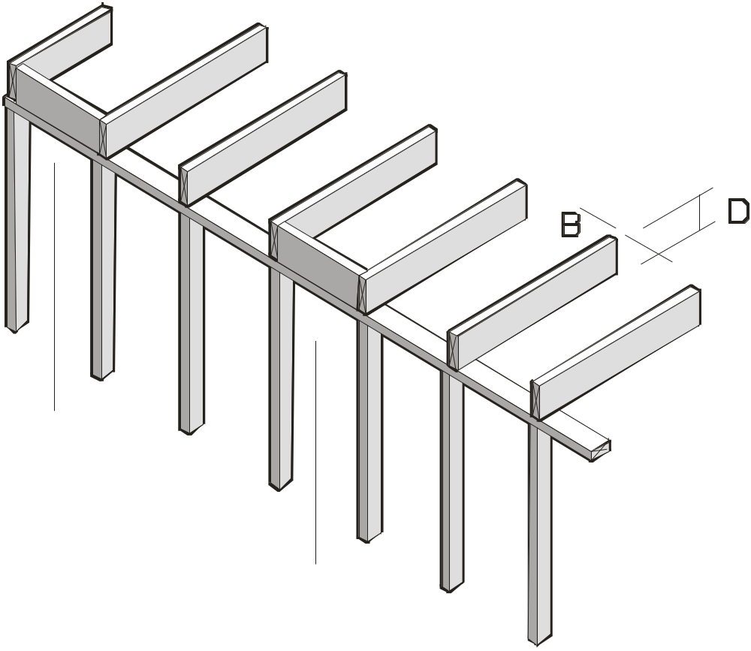
4.2.2.3 (b) solid blocking or herringbone strutting
Solid blocking or herringbone strutting at external and internal supports at not more than 1.8 m centres
Deep floor joist.
Depth (D) equal to or
greater than 4 x breadth (B)
1800 mm max.
Lower storey
top plate or bearer

Slide 48
4.2.2.3 Deep joists
In addition, for deep joists in unseasoned timber where the span exceeds 3.0 m and there is no ceiling installed on the underside of joists, herringbone strutting or solid blocking shall be provided between all joists in evenly spaced rows not exceeding 1800 mm centres.

Slide 49
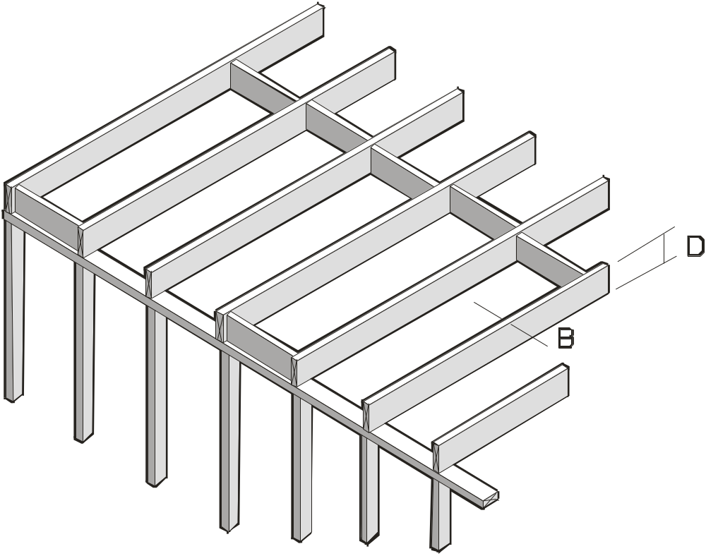
4.2.2.3 Deep joists
Additional blocking or strutting (mid-span) for unseasoned deep joist over 3 m span with no ceiling underneath
1800 mm max.

Slide 50
Because the bottom edge of unseasoned deep floor joist may tend to distort due to normal drying stresses, strutting or blocking is required for unseasoned joist over 3m that do not have a ceiling attached to restrain the bottom edge.
Mid-span strutting or blocking is NOT required for seasoned joist.

Slide 51
4.2.2.3 Deep joists
Where rim boards (see Clause 2.7.9) are used in conjunction with deep joists, including I-joist and floor systems, they shall be suitable to carry relevant uniform and point loads that may be transferred to the rim board via the plates.
A4

Slide 52
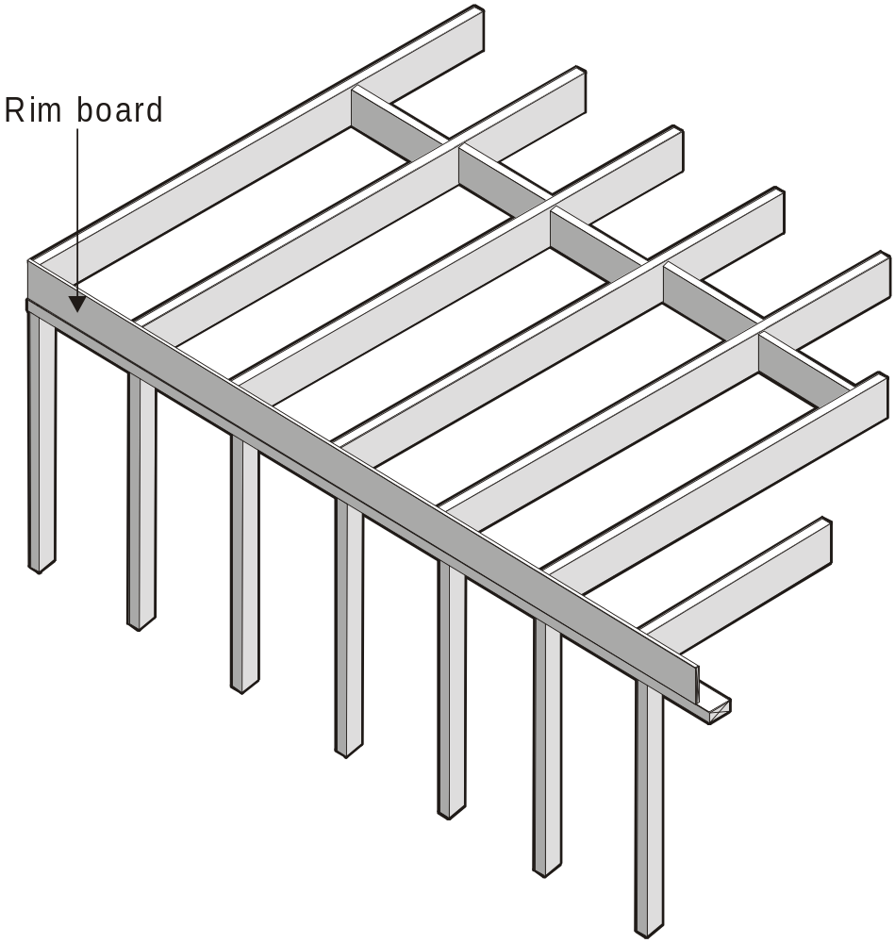

Slide 53
4.2.2.4 Fixing of joists to bearers or lower wall plates
Joists shall be fixed to bearers at all points of support (see Section 9).
Where joist hangers or specialist connections are utilised, joists shall be completely seated into the hanger and fixed to maintain structural integrity.

Slide 54
When joist hangers or specialist connections are used, manufacturer’s information must be consulted to determine the load carrying capacity of the connector.
Generally manufacturers will have design loads for the connectors for ‘Live load + Dead load’ and ‘Wind Uplift’.

Slide 55
FLOOR FRAMING
4.3 MEMBER SIZES

Slide 56
4.3 MEMBER SIZES
4.3.1 Bearers
4.3.1.1 Bearers supporting loadbearing walls
The size of bearers supporting single or upper storey loadbearing walls shall be determined from Span Tables 1 to 4 of the Supplements for floor load width (FLW) of 1200, 2400, 3600 and 4800 mm, respectively.

Slide 57
4.3.1.1 Bearers supporting loadbearing walls
The size of bearers supporting the lower storey of two storey loadbearing walls shall be determined from Span Tables 33 and 34 of the Supplements for floor load widths (FLW) of 1800 and 3600 mm, respectively.

Slide 58
4.3.1.1 Bearers supporting loadbearing walls
The tables are applicable only to loadbearing walls that are parallel to bearers and which distribute loads evenly along these bearers.
For bearers that support loadbearing walls at right angles or that support point loads refer Clauses 4.3.1.5 and 4.3.1.6 respectively.

Slide 59
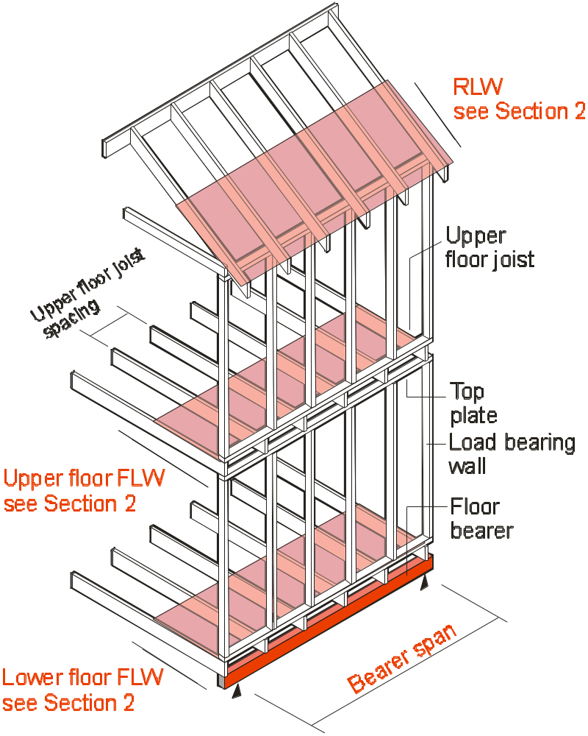
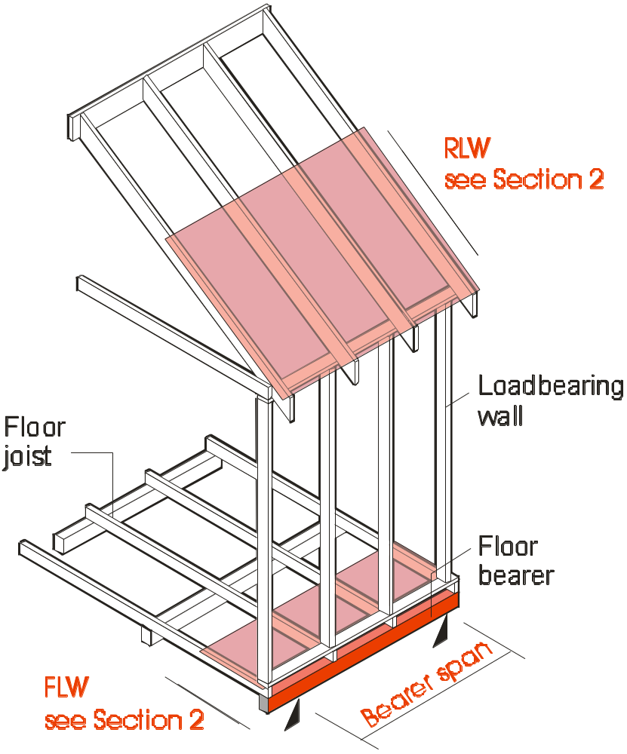
(a) Single or upper storey (b) Lower storey or two storey
FIGURE 4.6 BEARERS SUPPORTING LOADBEARING WALLS

Slide 60
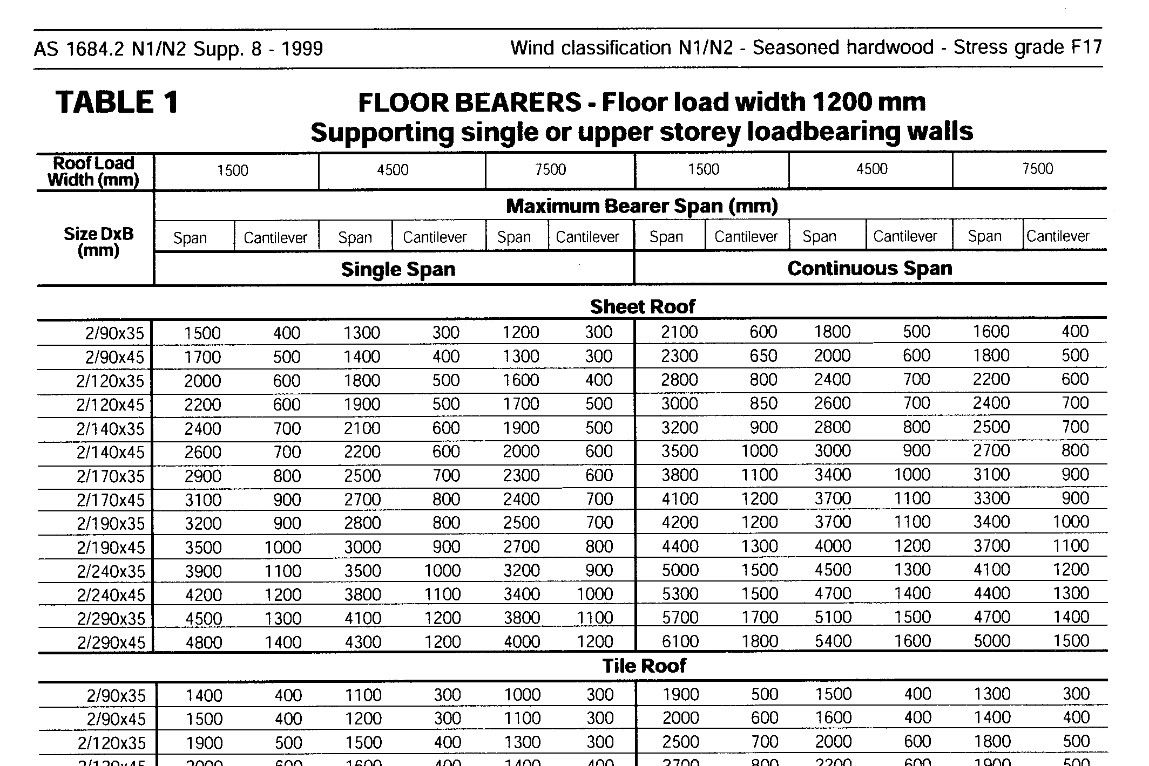
NOTE: Bearer tables are the same for all wind classifications

Slide 61
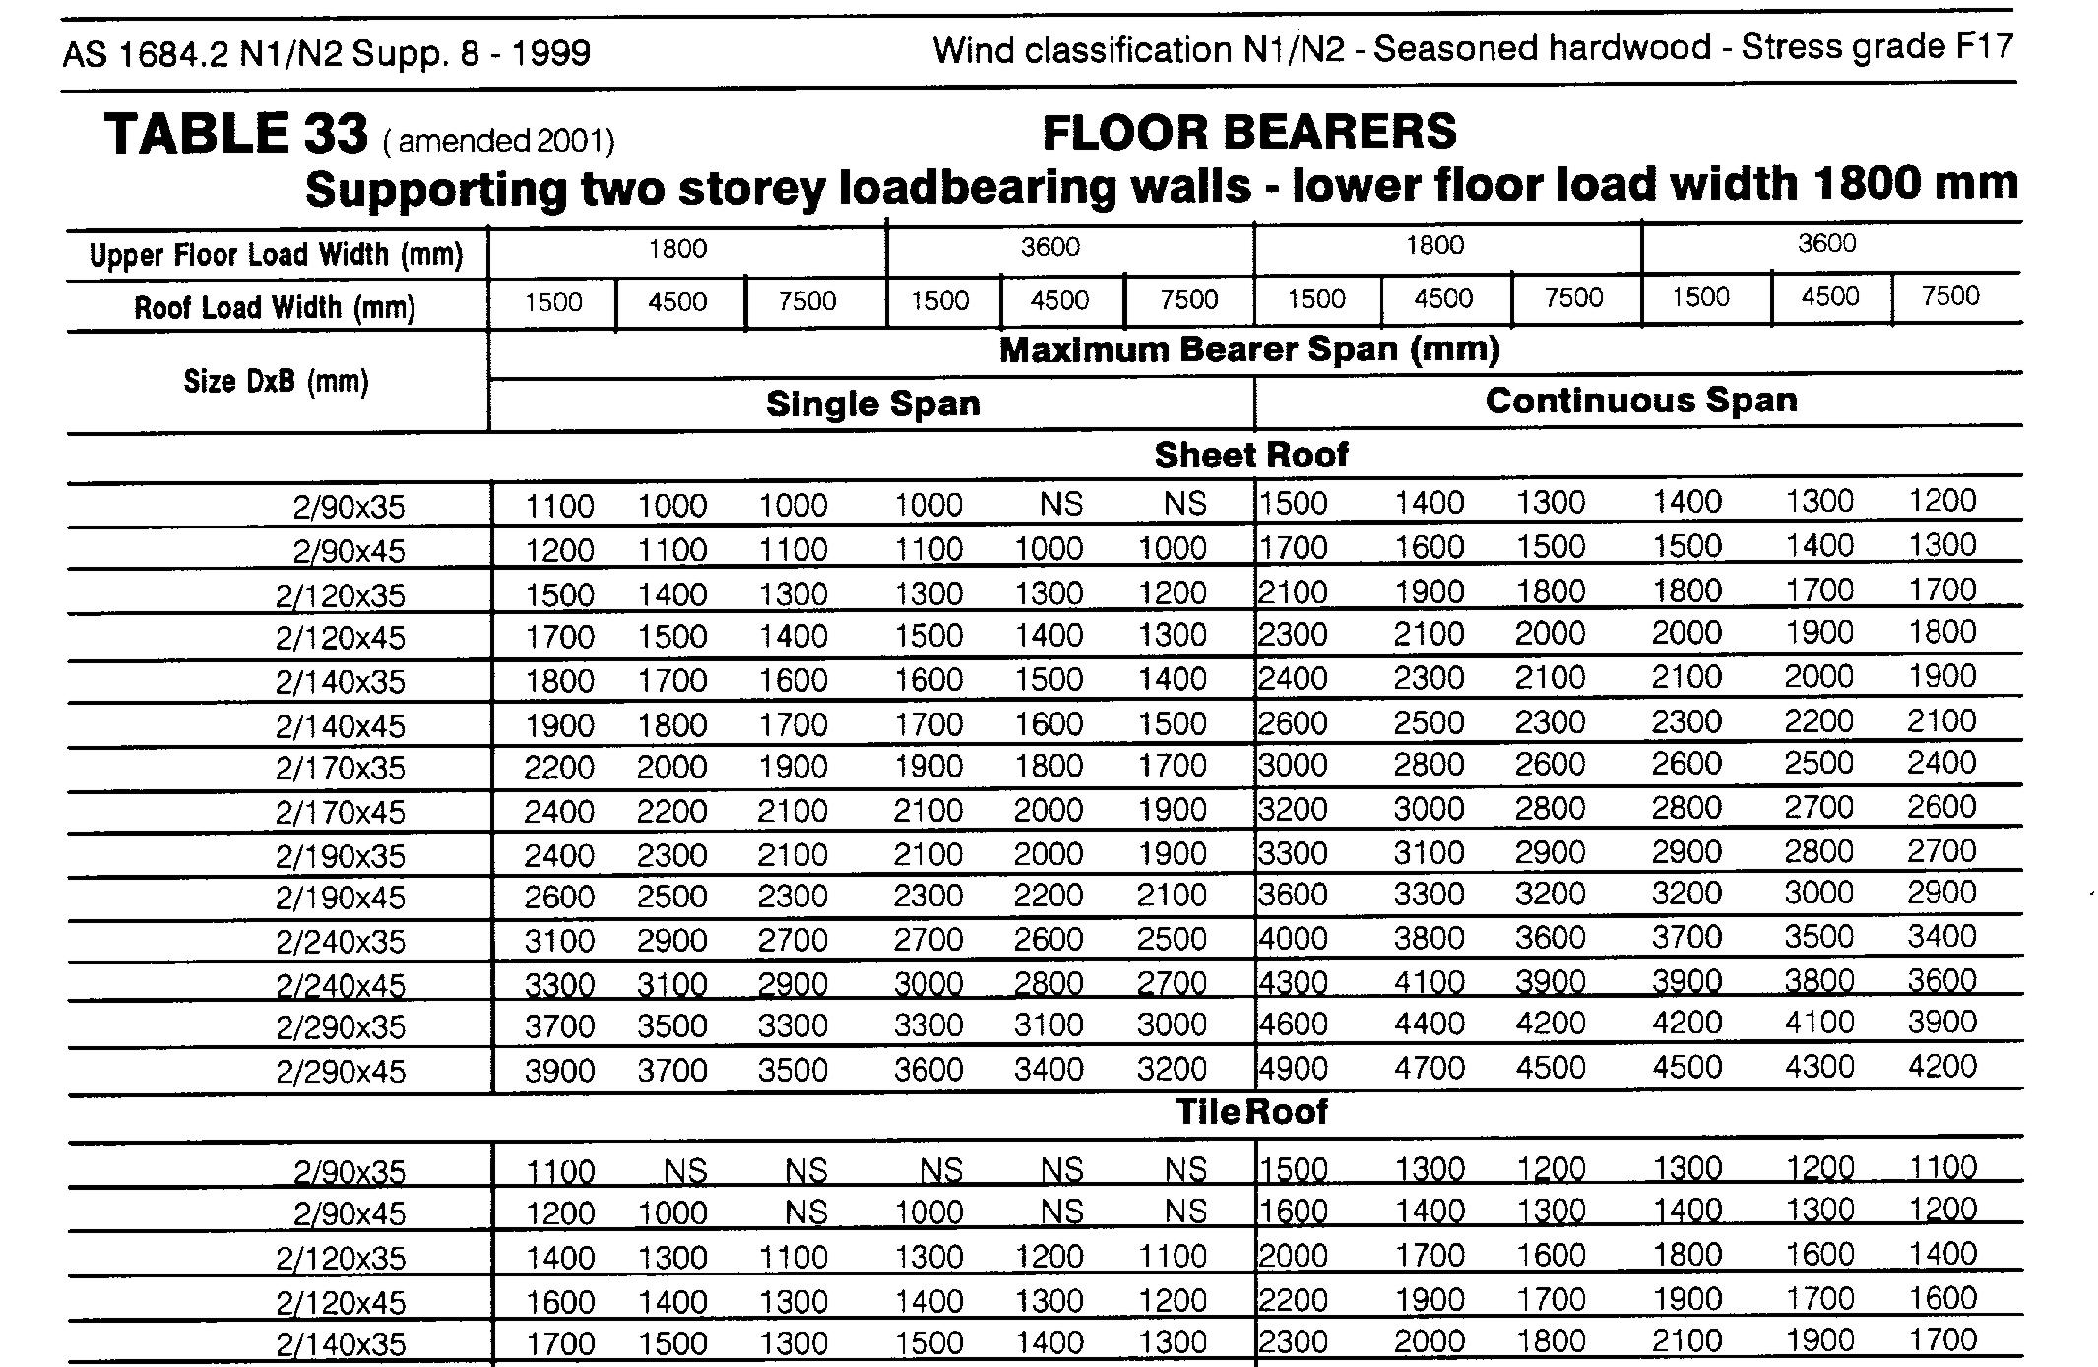
NOTE: Bearer tables are the same for all wind classifications

Slide 62
4.3.1.2 Bearers supporting floor loads only
For bearers supporting floor loads only or for decks located equal to or less than 1000 mm above the ground, the size of bearers shall be determined from Span Table 5 of the Supplements. For decks located greater than 1000 mm above ground, the size of bearers supporting floor loads shall be determined from Span Table 49 of the Supplements.

Slide 63
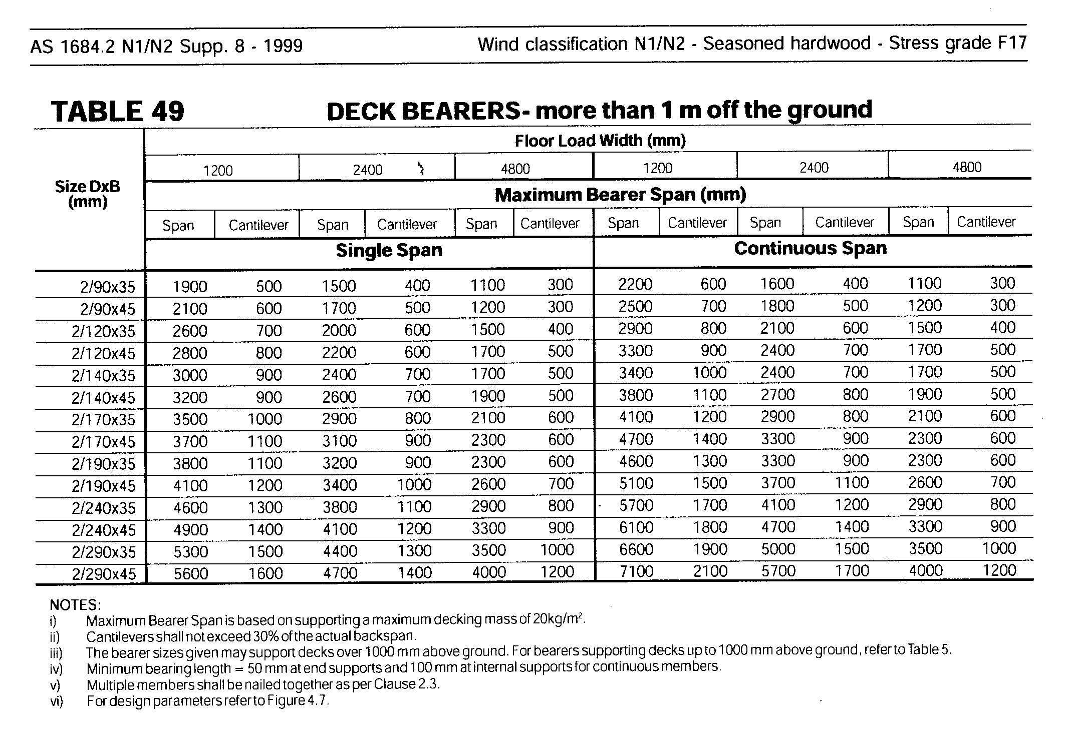
NOTE: Deck Bearer tables are the same for all wind classifications

Slide 64
‘AS 1170.1 Dead and live loads and load combinations’, which sets out the minimum design loads to be used for structures, requires that the floor live loads for houses to be 1.5 kPa
However ‘balconies’ (patios, verandahs etc.) 1000 mm or more above ground, are required to be 3kPa.

Slide 65
Therefore, deck bearers in the AS1684 span tables (Table 49) have been designed for strength using 3.0 kPa in accordance with the loading code.
Their stiffness however is checked using 1.5 kPa as per normal bearers (Table 5) so their sizes may not necessarily be larger than normal bearers ie where deflection controls design.
Also, deck bearers are calculated using a 20 kg/m² decking mass whereas normal bearers (Table 5) use a 40 kg/m² flooring mass.

Slide 66
NOTE: Where other than timber decking is used, eg compressed FC sheet, tiles etc. the total decking mass may exceed 20 kg/m². (15 mm thick compressed FC sheet is approx. 24 kg/m²)

Slide 67
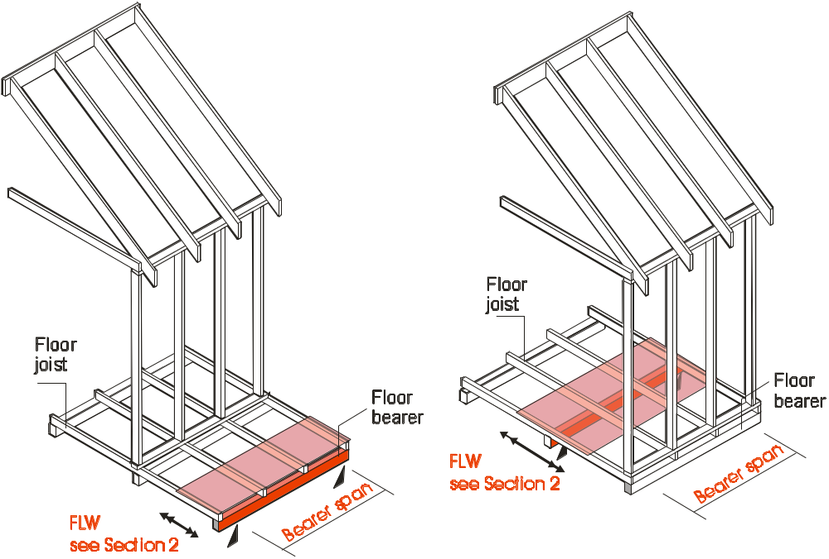
FIGURE 4.7 BEARERS SUPPORTING FLOOR LOADS ONLY

Slide 68
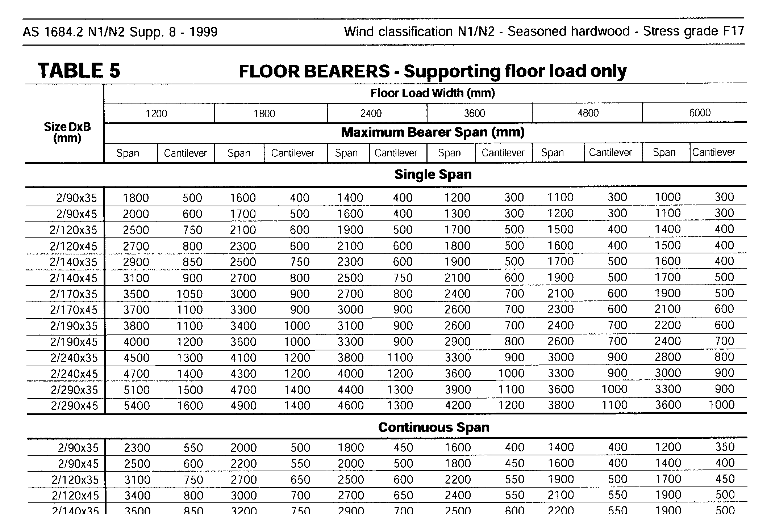

Slide 69
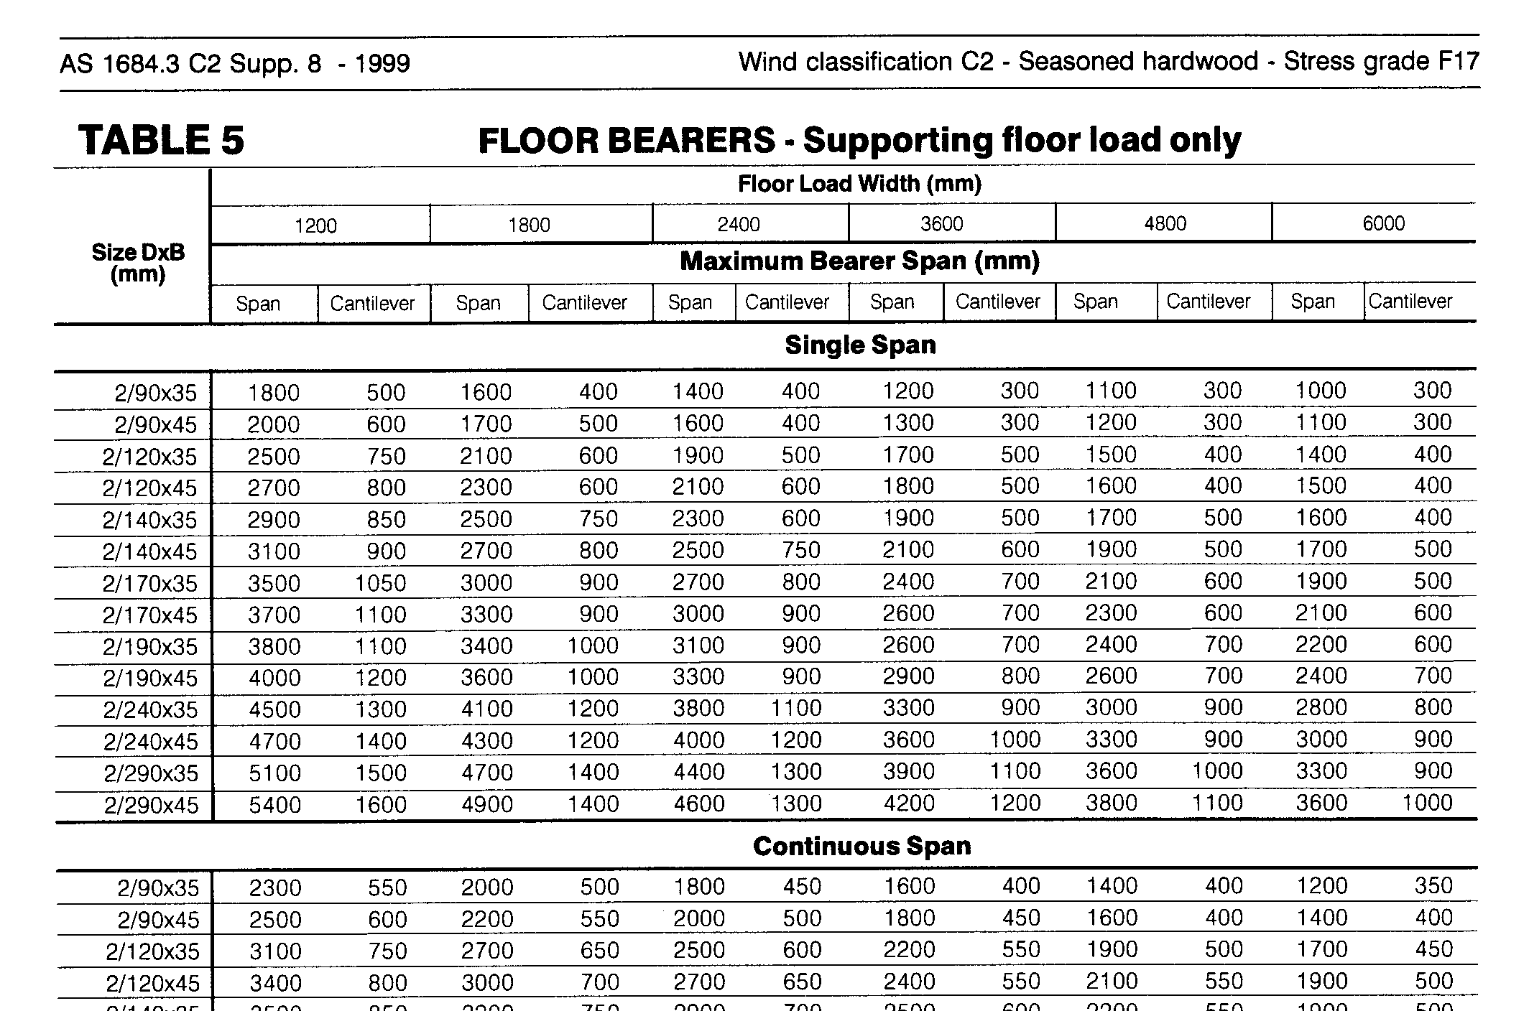

Slide 70
4.3.1.3 Bearers in lower storey supporting upper storey floor loads
The size of bearers in lower-storey construction supporting floor loads from the upper storey shall be determined from Span Table 35 of the Supplements.

Slide 71
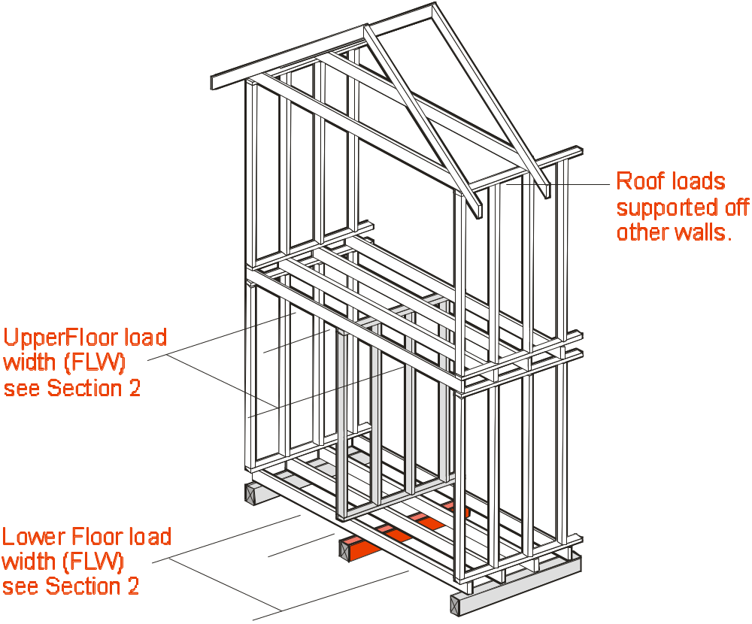
Bearers in lower storey supporting upper storey floor loads

Slide 72
NOTE: Bearer tables are the same for all wind classifications

Slide 73
4.3.1.4 Bearers supporting gable or skillion end walls
Bearers supporting non-loadbearing gable end walls shall be considered as for bearers supporting single storey loadbearing walls with a sheet roof and a roof load width (RLW) of 1500 mm (see Clause 4.3.1.1) ....... and the appropriate floor load width.
There are 3 methods of supporting
gable end walls ..............

Slide 74
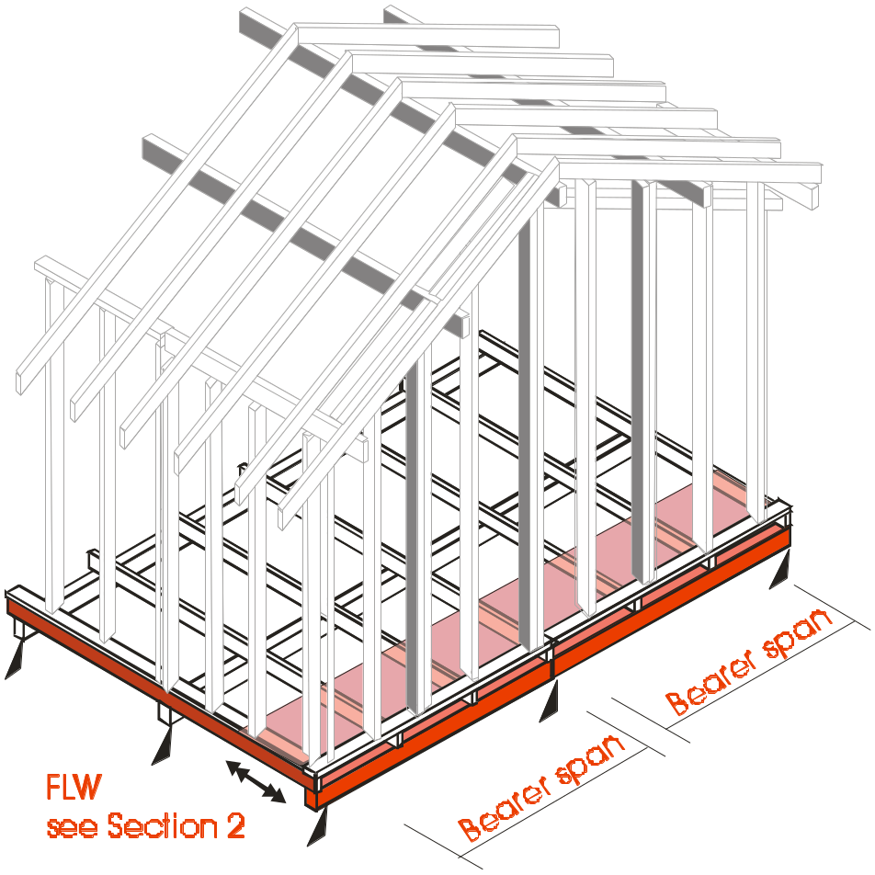
METHOD 1
Where the gable wall runs parallel to the bearers they are designed in accordance with 4.3.1.3.
If point loads from the support of roof beams are not directly supported by a stump etc. the bearer must be designed for these point loads. Refer Clause 4.3.1.6 and Table 4.3
Floor joist designed as supporting parallel loadbearing wall as per Clause 4.3.2.4.

Slide 75
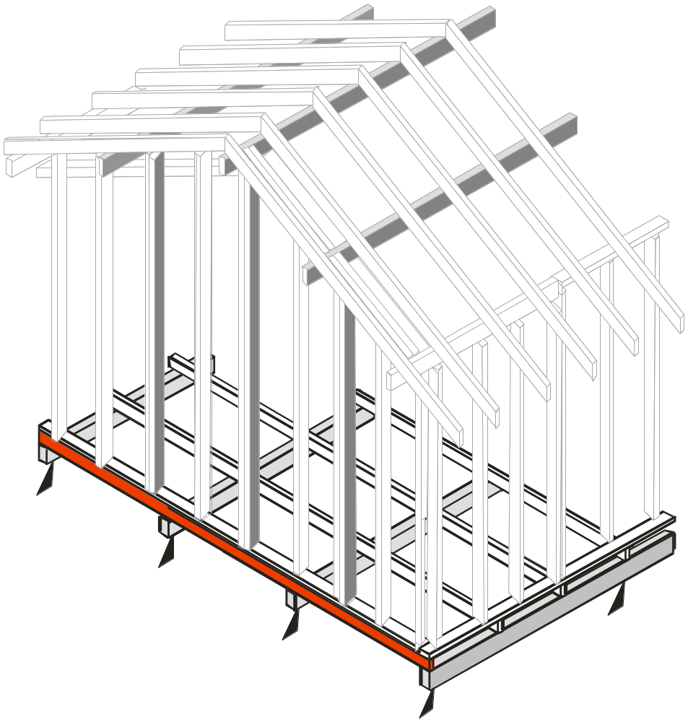
METHOD 2 (most common)
Where the gable wall runs at right angles to the bearers, the floor joist can be utilised to support the gable wall.
If point loads from the support of roof beams are not directly supported by a stump etc. the floor joist must be designed for these point loads. Refer Clause 4.3.2.4 and Table 4.4
Floor joist supporting
gable end wall

Slide 76
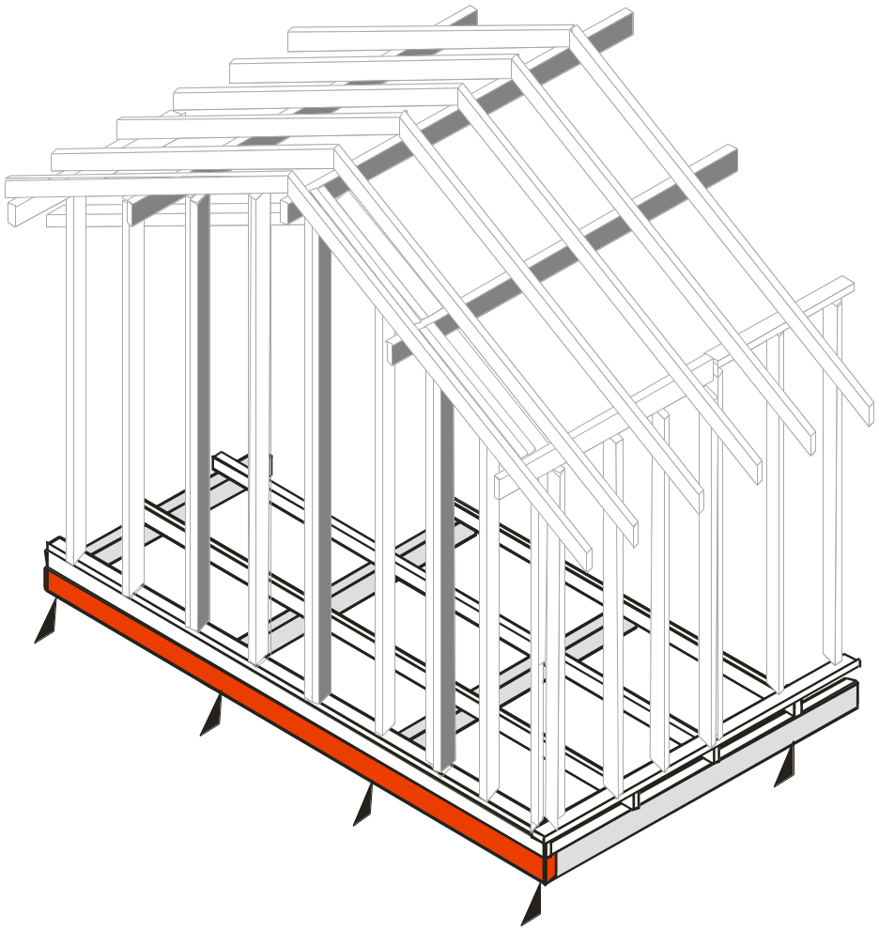
METHOD 3 (least cost effective)
Where the gable wall runs at right angles to the bearers, an extra bearer is placed parallel to the gable wall.
If point loads from the support of roof beams are not directly supported by a stump etc. the bearer must be designed for these point loads. Refer Clause 4.3.1.6 and Table 4.3
‘Extra’ bearer supporting
gable end wall

Slide 77
4.3.1.5 Single or upper storey bearers supporting loadbearing walls at right angles to their span
Where loadbearing walls are supported at or within 1.5 times the bearer depth from the bearer support, the bearer may be considered as not supporting roof loads. (see Figure 4.8).

Slide 78
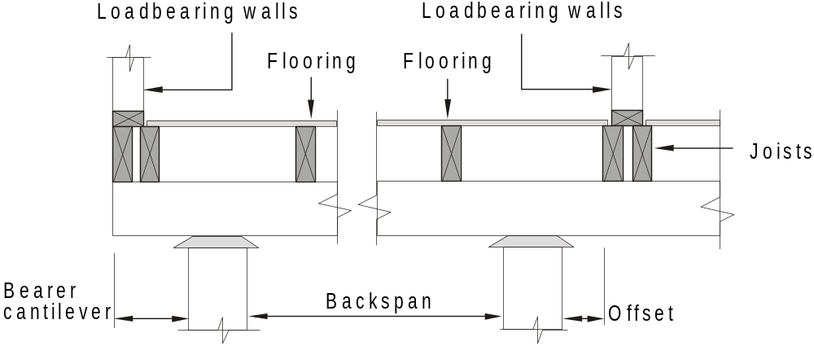
If the cantilever or offset is less than 1.5 times the depth of the bearer then the bearer is considered as NOT supporting roof loads
FIGURE 4.8 OFFSETS AND CANTILEVERS

Slide 79
4.3.1.5 Single or upper storey bearers supporting loadbearing walls at right angles to their span
Where the loadbearing wall occurs outside 1.5 times the depth of the bearers from its support, the allowable offset or cantilever shall be determined from Table 4.2
(see also Figure 4.8).

Slide 80
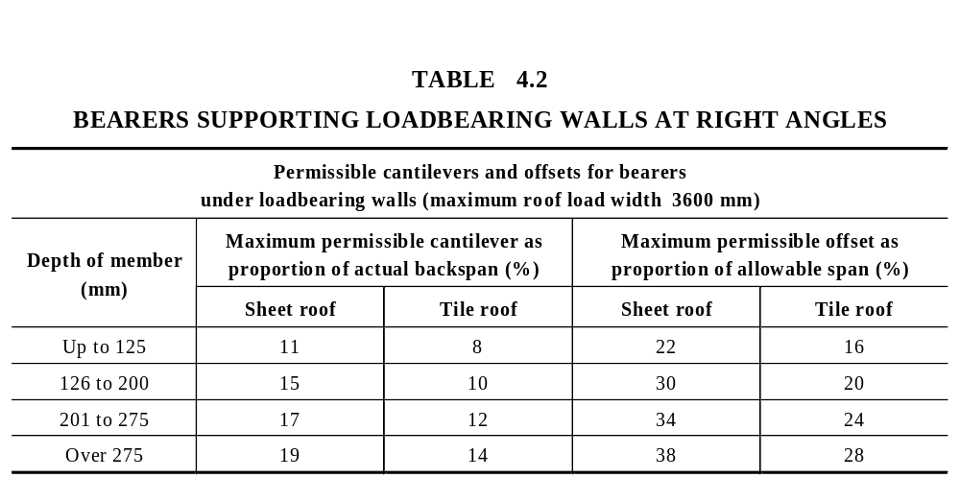

Slide 81
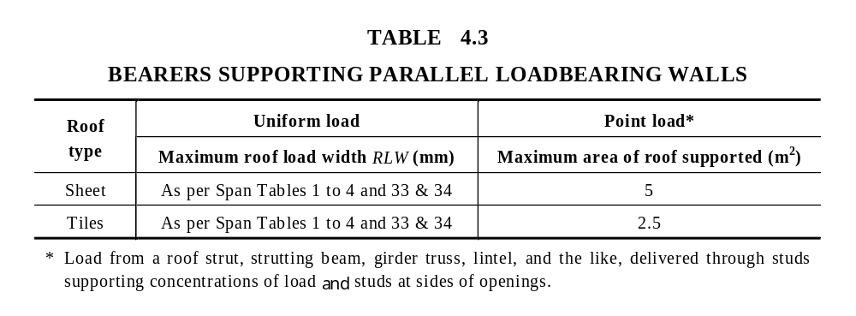
4.3.1.6 Bearers supporting roof point loads
The maximum roof point loads that bearers can support are given in Table 4.3.

Slide 82
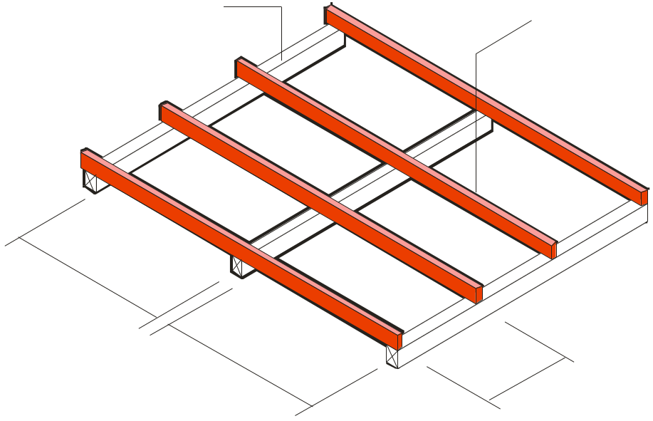
4.3.2 Floor Joist
4.3.2.1 General
The size of floor joists shall be determined from Span Table 6 of the Supplements.
Floor bearer
Floor Joist
Joist Span
Joist Span
Joist
Spacing
FIGURE 4.9 FLOOR JOISTS (a) Design parameters

Slide 83
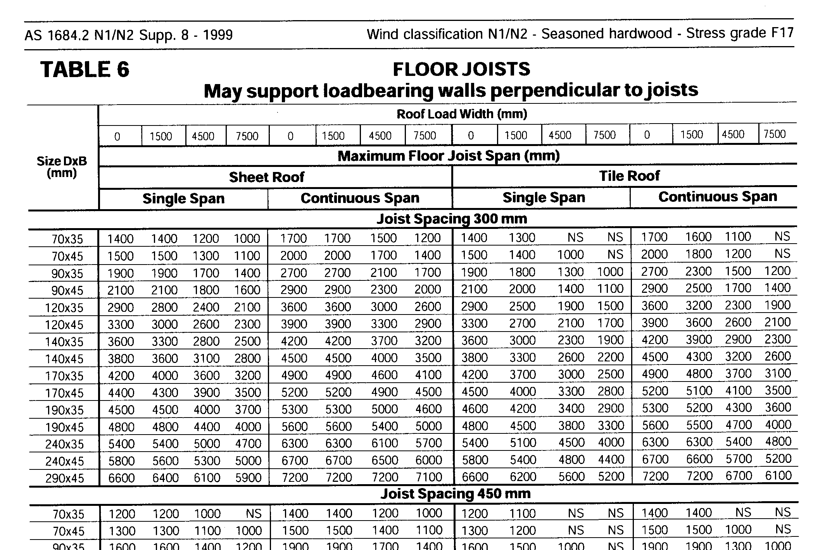
NOTE: Floor Joist tables are the same for all wind classifications

Slide 84
4.3.2.1 General
The size of joists for decks located more than 1000 mm above the ground shall be determined from Span Table 50 of the Supplements.

Slide 85
‘AS 1170.1 Dead and live loads and load combinations’, which sets out the minimum design loads to be used for structures, requires that the floor live loads for houses to be 1.5 kPa
However ‘balconies’ (patios, verandahs etc.) 1000 mm or more above ground, are required to be 3kPa.

Slide 86
Therefore, deck joists in the AS1684 span tables (Table 50) have been designed for strength using 3.0 kPa in accordance with the loading code.
Their stiffness however is checked using 1.5 kPa as per normal joists (Table 6) so their sizes may not necessarily be larger than normal bearers ie where deflection controls design.
Also, deck joists are calculated using a 20 kg/m² decking mass whereas normal joists (Table 5) use a 40 kg/m² flooring mass.

Slide 87
NOTE: Where other than timber decking is used, eg compressed FC sheet, tiles etc. the total decking mass may exceed 20 kg/m². (15 mm thick compressed FC sheet is approx. 24 kg/m²)

Slide 88
NOTE: In most cases, joist sizes determined using Table 50 (Deck Joist – more than 1 m off the ground) will in fact be a smaller size than those determined from standard floor joist Table 6.
This is due to the joist sizes in Table 50 being calculated using a decking mass of 20kg/m² whereas the joist sizes in Table 6 are calculated using a flooring mass of 40kg/m² .

Slide 89
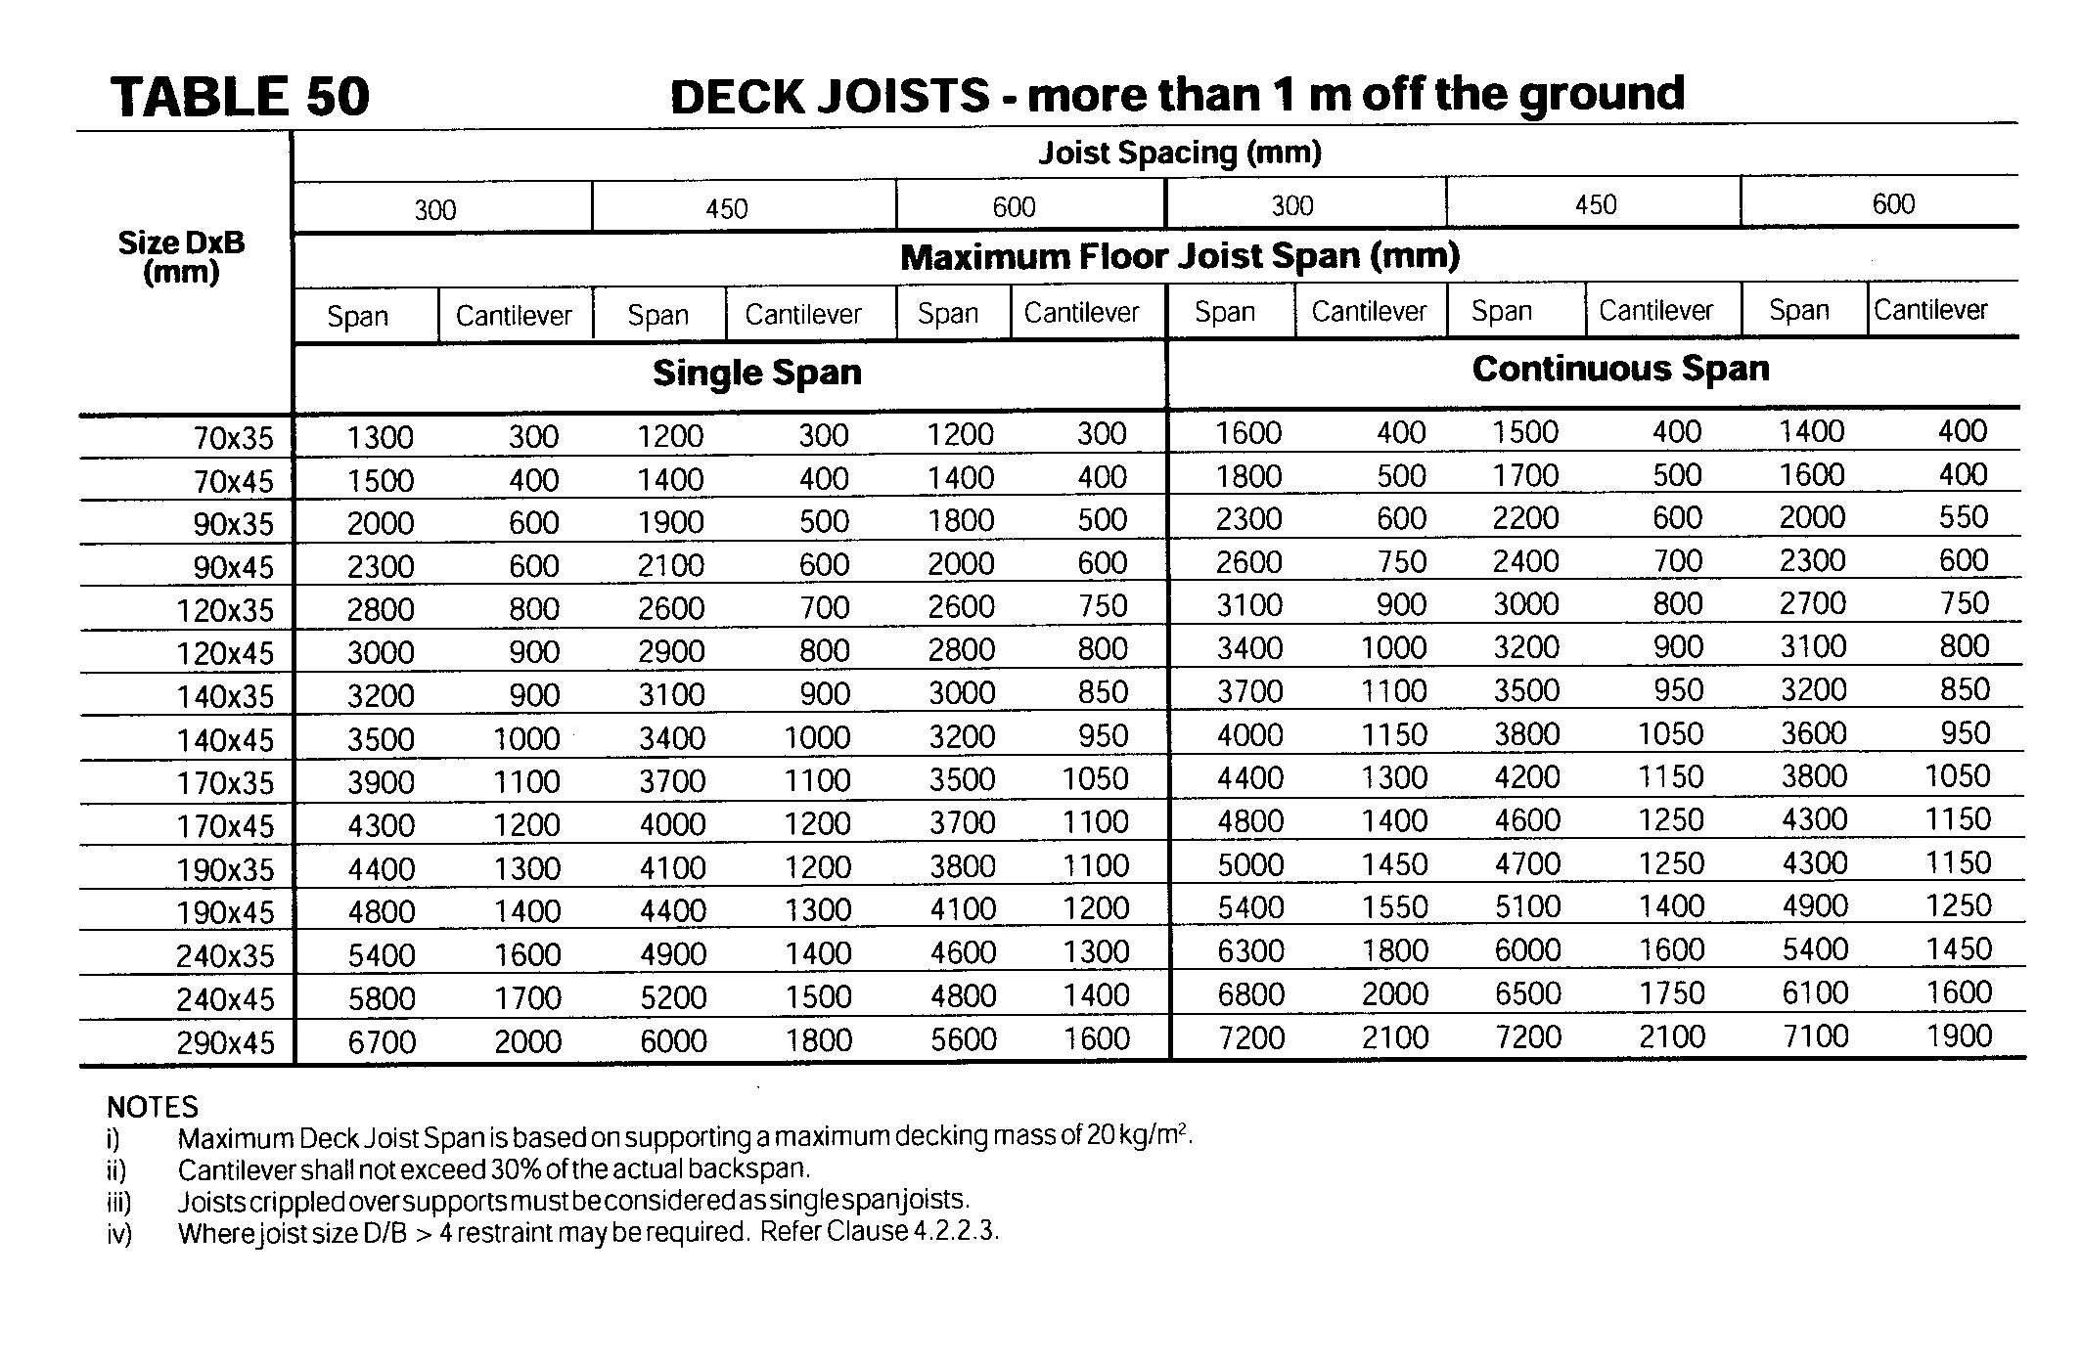
NOTE: Deck Joist tables are the same for all wind classifications

Slide 90
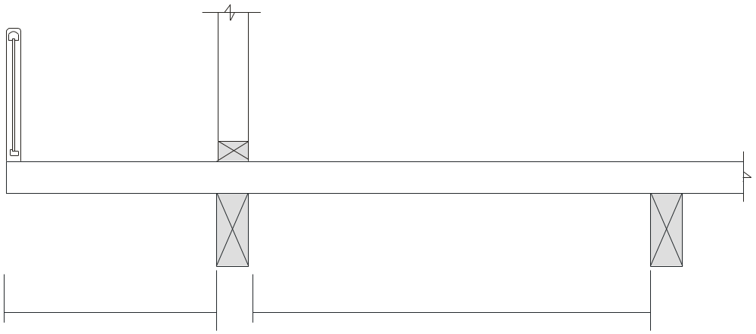
4.3.2.1 General
For floor joists supporting floor loads only, floor joists may cantilever up to 25% of their allowable span provided that the minimum backspan is at least twice the cantilever distance.
Max. cantilever =
25% allowable span
Min. backspan =
2 x cantilever

Slide 91
4.3.2.2 Floor joists supporting gable or skillion end walls
The size of joists supporting non-loadbearing gable end walls shall be the same size as the adjacent floor joists. Unless required for the support of flooring, a single joist may be used.
If point loads from the support of roof beams are not directly supported by a stump etc. the floor joist must be designed for these point loads.
Refer Clause 4.3.2.4 and Table 4.4.

Slide 92
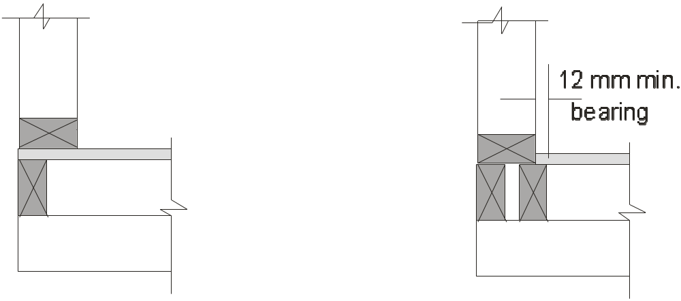
4.3.2.2 Floor joists supporting gable or skillion end walls
Single joist may be used at gable ends for platform floors.
Double floor joist are required at gable ends for cut-in (fitted) floors.

Slide 93
4.3.2.3 Floor joists supporting loadbearing walls at right angles to joists
Where loadbearing walls are offset up to 1.5 times the joist depth from the supporting bearer or wall, the joist may be considered as supporting floor loads only (see Figure 4.9).

Slide 94
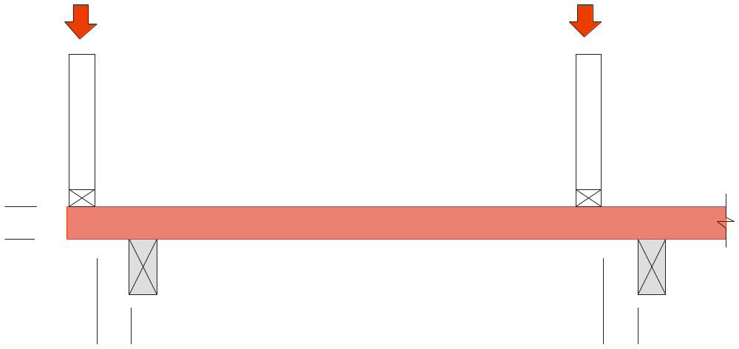
Roof Load
Roof Load
Floor Joist is considered as supporting floor loads only
D
1.5 D max.
1.5 D max.
(b) Loadbearing wall offset or cantilever
within 1.5 times the depth of the joist.
FIGURE 4.9 FLOOR JOISTS

Slide 95
4.3.2.3 Floor joists supporting loadbearing walls at right angles to joists
In single- or upper-storey floors, where the loadbearing wall (no point loads) occurs within the middle half of the span of the joist, the joist size shall be determined from Span Table 6 of the Supplements for the appropriate roof load width (RLW).

Slide 96
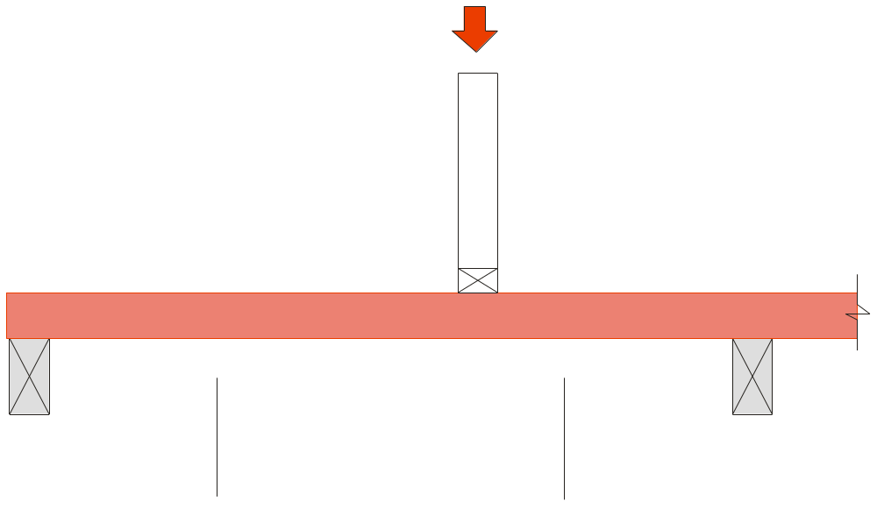
Roof Load
Floor Joist determined from Span Table 6
Middle half of span
(b) Loadbearing wall offset within
the middle half of the span
FIGURE 4.9 FLOOR JOISTS

Slide 97
4.3.2.3 Floor joists supporting loadbearing walls at right angles to joists
For loadbearing walls supported by cantilevered floor joists, the maximum cantilever shall not exceed 15% of the allowable span determined from the Span Table 6 for the appropriate roof load width (RLW), and the minimum backspan shall be at least four times the cantilever distance.

Slide 98
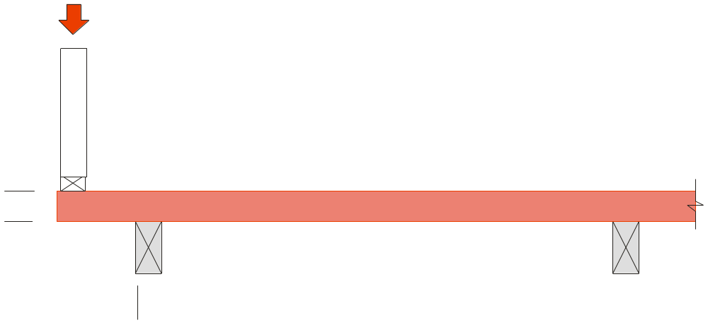
Roof Load
When the floor joist cantilever is greater than 1.5 x D then the cantilever shall not exceed 15% of the allowable span determined from the Span Table 6 for the appropriate roof load width (RLW)
D
Min. backspan = 4 x cantilever
15% of allowable span max.
(b) Loadbearing wall offset or cantilever
within 1.5 times the depth of the joist.
FIGURE 4.9 FLOOR JOISTS

Slide 99
4.3.2.3 Floor joists supporting loadbearing walls at right angles to joists
In the lower-storey of a two-storey construction, floor joists shall not support loadbearing walls within their spans.

Slide 100
4.3.2.4 Single or upper storey floor joists supporting roof point loads and
loadbearing walls parallel to joists
For RLW = 0, floor joist sizes determined from Span Table 6 may support roof point loads and loadbearing walls parallel to joists in accordance with Table 4.4.
Where multiple joists are used, the maximum RLW or point load area may be increased in proportion to the number of additional joists.

Slide 101
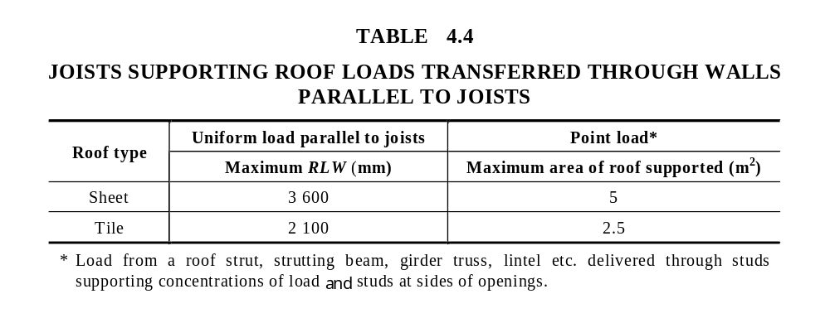

Slide 102
The most common occurrence of uniform and point roof loads parallel to joist are at hip ends and, internally, loads from pitched roofs brought down from roof struts, strutting beams etc. In most cases, the above limits will be adequate.
The worst situation occurs when floor joists are placed at 90^{O} to the main rafters or trusses. This configuration should be avoided if possible.

Slide 103
4.3.2.5 Openings in floors
Trimming joists and trimmers supporting curtailed joists shall be of the same size, and shall not be less in size than the associated floor joists.

Slide 104
4.3.2.5 Openings in floors
Trimmers between 1000 mm and 3000 mm in length shall have their breadth increased, including the breadth of trimming joist, by at least 20% more than the common joist breadth for each 300 mm in length, or part thereof, greater than 1000 mm.
Trimmers exceeding 3000 mm shall be designed as bearers.

Slide 105
4.3.2.5 Openings in floors
Trimmers and curtailed joists greater than 1000 mm shall not rely solely on the strength of nails into end grain and shall be suitably connected (e.g. metal nailplate connectors). (see Figure 4.10).

Slide 106
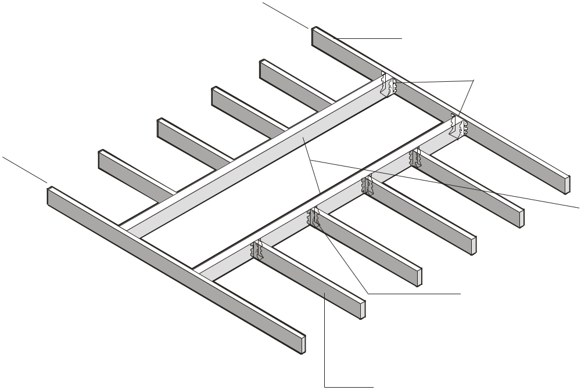
Trimming Joist
3000 mm max.
Metal connectors when span of trimmers exceeds 1000mm.
Trimmers
Metal connectors when span of trimmed joist exceeds 1000mm.
Curtailed joists (trimmed joist)
FIGURE 4.10 OPENINGS IN FLOORS

